Slide 1

BlockChain Odyssey: Revolutionizing Cross-Border Payments
This presentation explores the innovative BlockChain Odyssey solution, a secure and scalable cross-border payment service built using GoFr and blockchain technology. This service addresses the limitations of traditional cross-border payments by offering faster, cheaper, and more transparent transactions.
by go_lang_warriors
Soumyajyoti Sarkar
Anikesh Kumar
Prabhav GK
Shrihari C
Notes:
1

Slide 2


Problem: Inefficient Cross-Border Payments
1
High Transaction Fees
2
Slow Processing Times
Traditional payment systems often charge exorbitant fees, making international transfers expensive.
Cross-border payments can take several days to complete, hindering timely transactions.
3
Security Concerns
Traditional payment systems are vulnerable to fraud and data breaches, compromising security and trust.
Notes:
2

Slide 3
Solution: BlockChain Odyssey
GoFr Framework
Blockchain Integration
GoFr's modular microservices enable building a flexible and scalable backend for transaction management, user authentication, and KYC/AML processing.
Integrating blockchain technology leverages its immutability and smart contracts to secure and automate payment flows, making transactions transparent and traceable.
Notes:
3

Slide 4




Key Features
Secure Payment Flows
Blockchain's decentralized ledger ensures the safety and transparency of all transactions, eliminating the risk of fraudulent activities.
Cross-Currency Support
The system facilitates payments in multiple currencies, allowing users to send and receive funds in their preferred currencies.
Smart Contract Automation
Smart contracts automate the execution of payment transactions, guaranteeing the fulfillment of terms and conditions between parties.
Notes:
4

Slide 5
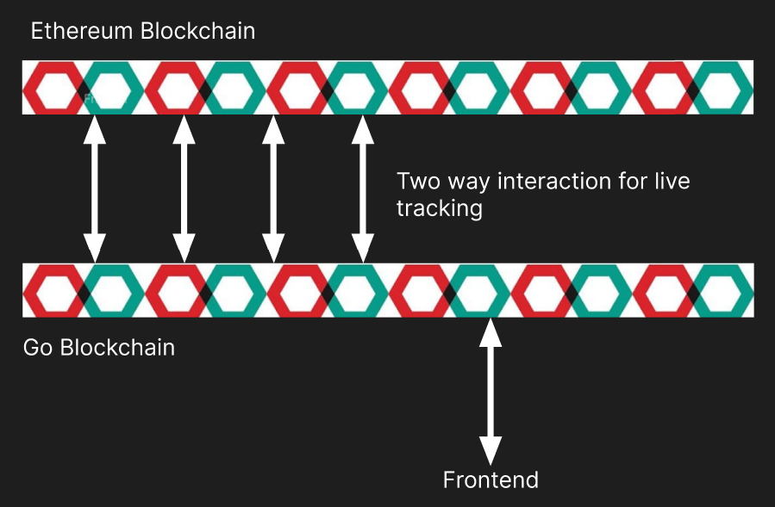
Flowchart
Notes:
3

Slide 6

Benefits of BlockChain Odyssey
Reduced Transaction Fees
Faster Processing Times
Blockchain's real-time processing capabilities enable near-instantaneous cross-border payments, streamlining the transaction process.
Blockchain's decentralized nature eliminates the need for intermediaries, significantly reducing transaction costs.
Enhanced Security
Blockchain's immutable ledger and cryptography ensure secure and tamper-proof transaction records, building trust and confidence in the system.
Notes:
5

Slide 7
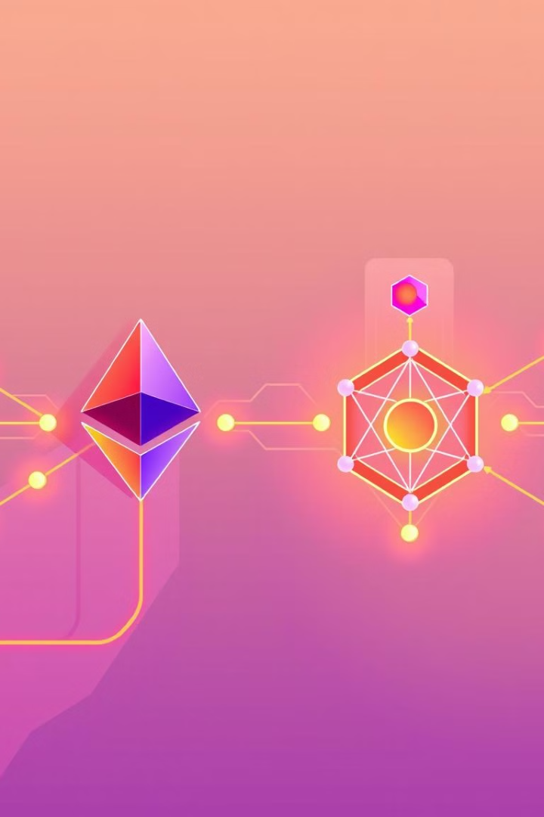
Dual Blockchain Tracking
Go-based Blockchain
Ethereum Blockchain
Continuous Monitoring
Transaction Tracking
Real-time Updates
Immutable Transaction Records
Notes:
6

Slide 8





GoFr Microservices
User Management
Wallet Management
Transaction Processing
KYC/AML Processing
Handles user registration, authentication, and account management.
Provides secure storage and management of user funds.
Ensures compliance with Know Your Customer and Anti-Money Laundering regulations.
Facilitates the initiation, execution, and completion of cross-border payments.
Notes:
7

Slide 9

BlockChain Odyssey: The Future of Cross-Border Payments
BlockChain Odyssey is poised to disrupt traditional payment systems, offering a secure, efficient, and transparent solution for cross-border payments. This innovative technology has the potential to reshape the global financial landscape, empowering individuals and businesses with faster, cheaper, and more accessible international transactions.
Notes:
8

